Slide 1
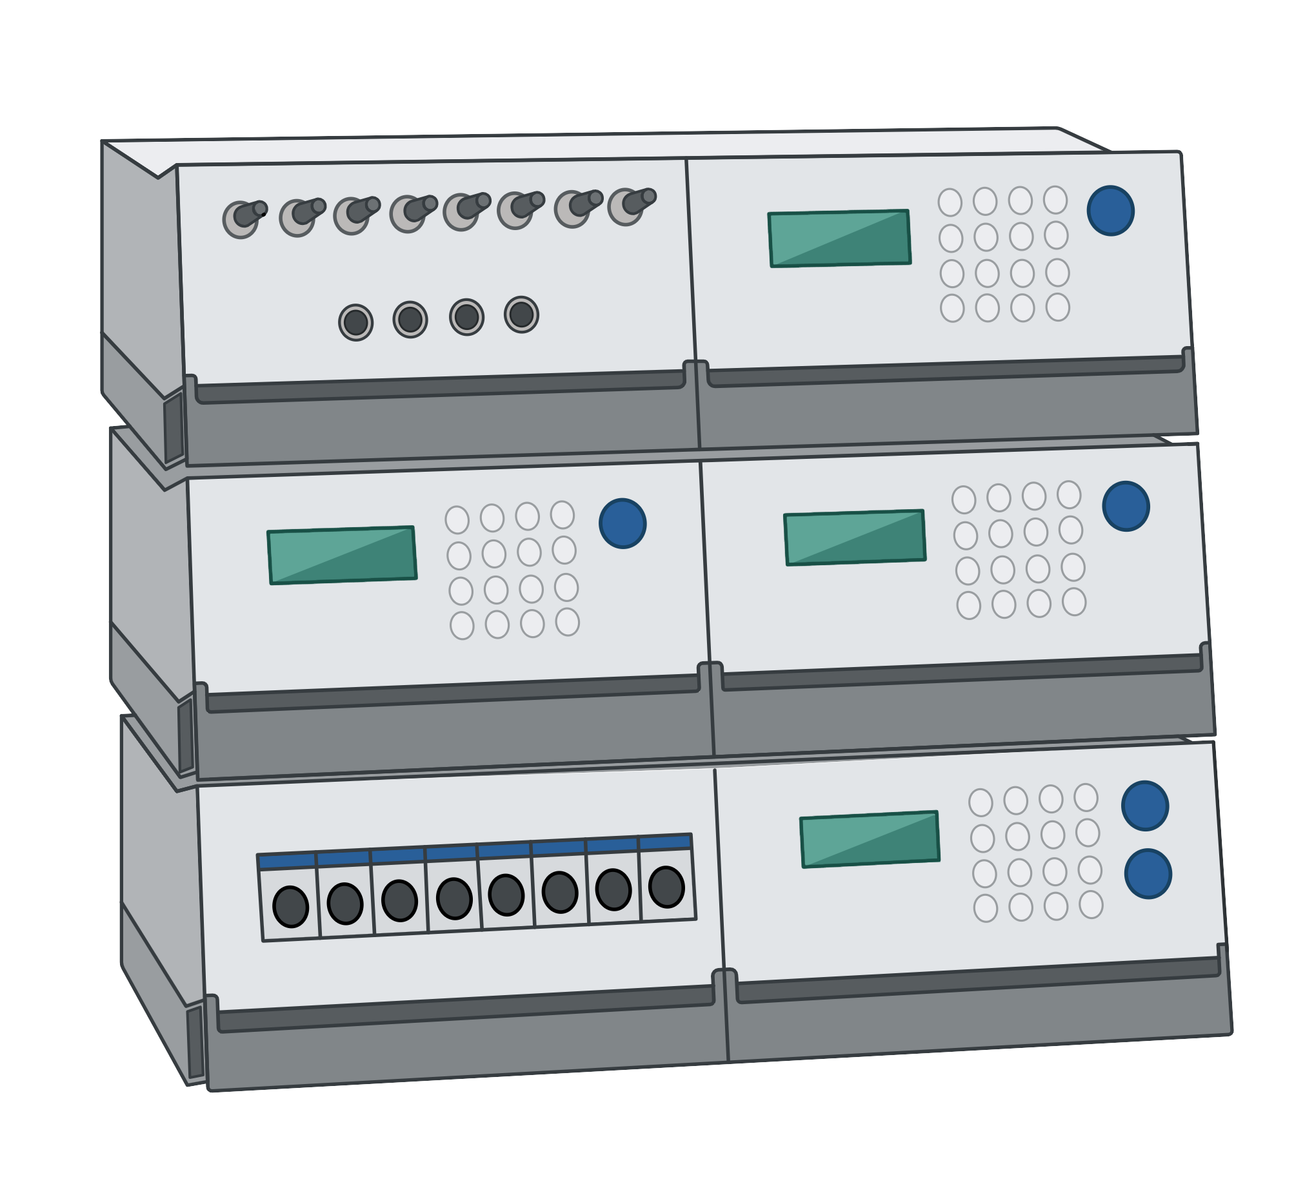

Autofeed script project
What we did
How it works
How to use it
F.Cal values

Slide 2
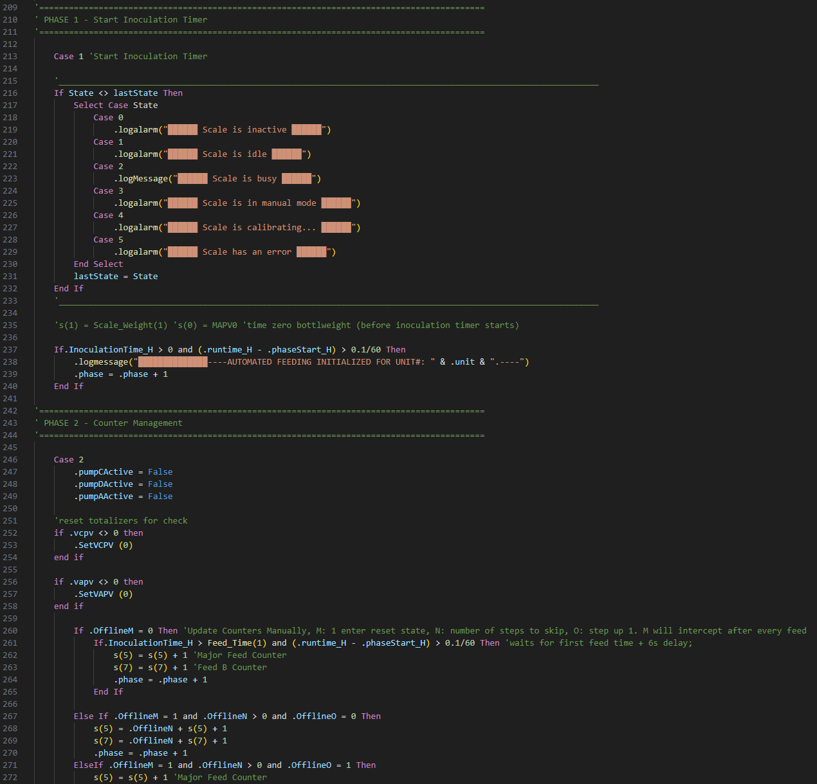


What we did
Developed an auto feed script for bioreactors.
Enhanced automation of feed operations.
Minimized manual intervention.
Increased precision in feed timing and volume.
Notes:
In our recent project, Colin and I made some major upgrades to the auto feed script designed for integration with bioreactors.
This script aims to enhance the automation process, streamlining feed operations and ensuring precise control over the feeding schedule.
Our primary objective was to minimize manual interventions and improve the accuracy of feed volumes and timing, thus increasing overall process efficiency.

Slide 3
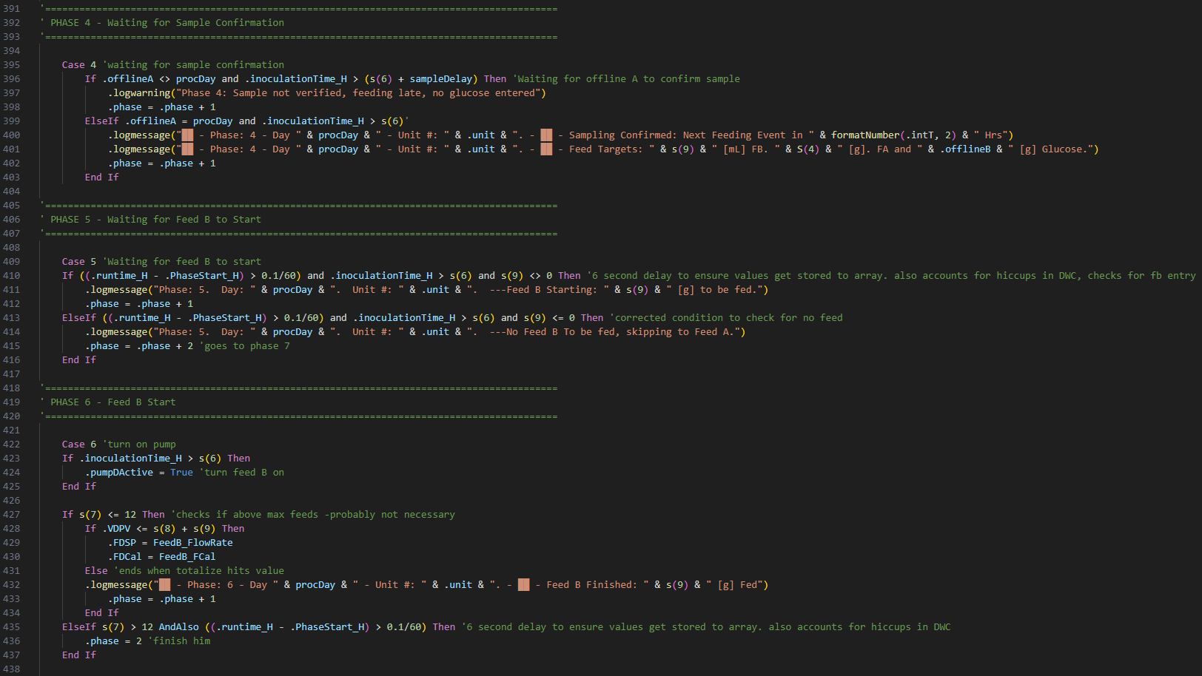
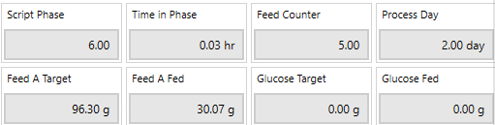
What we did Cont.
Implemented fail-safe system for scale disconnection.
Enabled manual glucose input with sample confirmation automation.
Introduced 17-phase system to optimize bioreactor script usage.
Feeds are tracked
Notes:
We added a fail-safe system for the scale, when it disconnects the feeds will stop till the user reconnects the scale.
We added a 17-Phase system, this works best for the script with the usage for the bioreactor. I will elaborate on that in a minute.
Then we also added a sample delay, which means that the script waits for the user to enter glucose value and waits for sample before feeding. How ever if the sampling is not confirmed the script will feed 4 hours after the scheduled time of the delay and give a warning.
Feeds no longer need to be manually tracked, the script saves it to internal values and prints out the feed amounts in the log
It will also function between the different DASgips and, also the new bioreactors which will be installed this month. Will also be compatible with other scripts

Slide 4
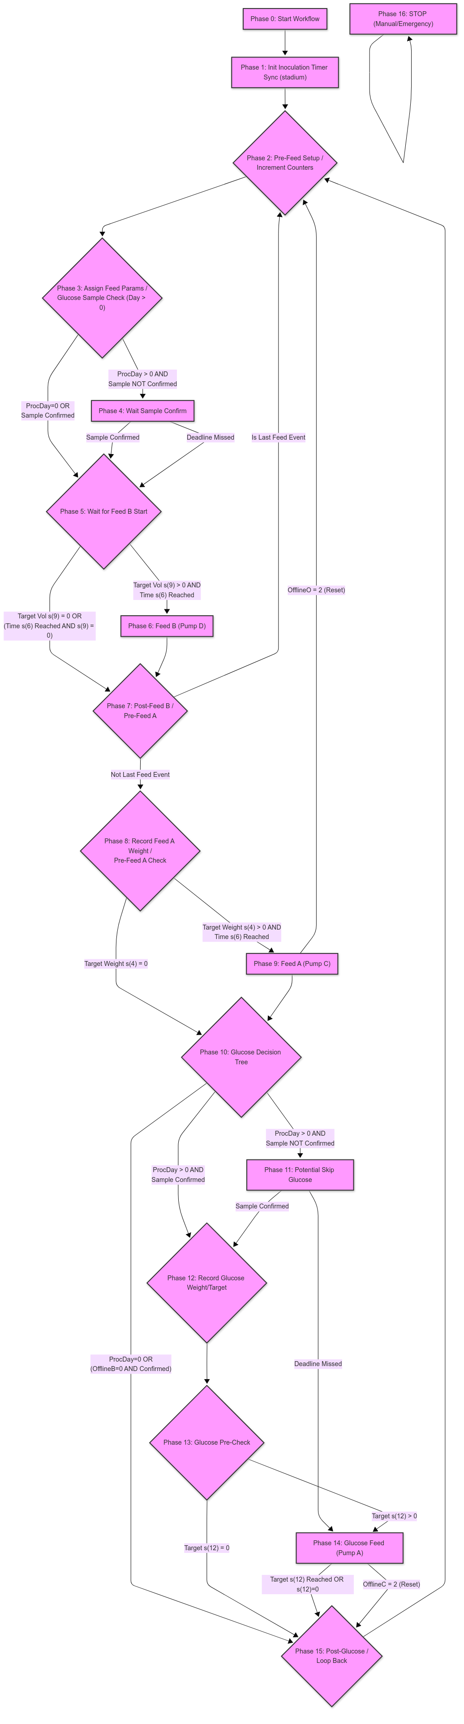
How it works
Phase 0: Initialization workflow.
Phase 1: Wait for process start.
Phase 2: Prepare for feeding.
Phase 3: Set feed targets.
Phase 4: Confirm glucose sample.
Phase 5: Start volumetric feed.
Phase 6 & 7: Execute feed.
Phase 8-15: Adjust post-feed and add glucose.
Phase 16: Emergency Stop.
Phase-By-Phase Explanation (0-16)
Feed Arrays: Indices 1-12
Notes:
Initialization (Phase 0):
"We start with Phase 0, the Initialization phase. This is where we prepare the system by initializing all necessary variables and memory. It's crucial for setting the stage for the automation workflow, ensuring everything is ready for the rest of the phases.”
Inoculation Monitoring (Phase 1):
"In Phase 1, we wait for the inoculation process to officially begin. The system constantly monitors the inoculation time, and once it detects activity, it logs this and transitions to the next phase. This ensures that our feed process is perfectly timed with the start of inoculation.“
Feed Preparation (Phase 2):
"Phase 2 involves preparing for the feed event. At this point, we deactivate all pumps to start fresh and increment our feed counters based on predefined schedules. This step ensures accurate and controlled feeding sequences.“
Feed Target Assignment (Phase 3):
"During Phase 3, we assign target values for the feeding event. The system checks for glucose sample confirmation, which is essential for maintaining feed accuracy and quality."
Glucose Confirmation (Phase 4):
"In Phase 4, we await confirmation of the glucose sample from the operator. If confirmed, we proceed to the next steps; if not, it will skip the glucose feed and move on to the next phase."
Feed Execution (Phases 5-7):
"Phases 5 through 7 cover the execution of Feed B. This includes the initiation and completion of volumetric feeding. Pumps are activated, and the system meticulously monitors the feeding volume, logging each step to ensure traceability and control."
Post-Feed Adjustments (Phases 8-15):
"After feeding, Phases 8 to 15 handle all post-feed adjustments. This includes any necessary glucose additions, ensuring the system returns to a ready state for the next scheduled feeding cycle."
Emergency Protocol (Phase 16):
"Finally, Phase 16 is our Emergency Stop phase. This is a critical safety feature allowing for a manual or automated shutdown to protect both the system and product integrity during any unforeseen issues."
We have more details on the diagram and can provide more training to anyone that wants it.

Slide 5
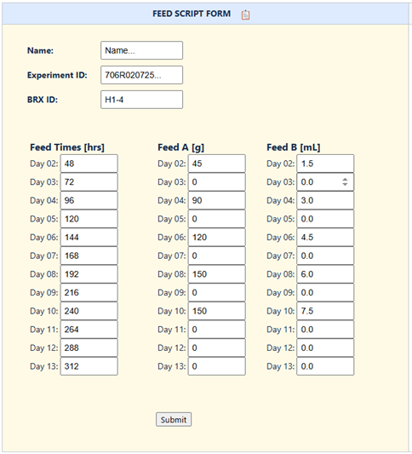
How to use it
Setup: Retrieve script.
Configure: Set feed times and targets.
Check: Script log.
Job Aid
Notes:
Setup:
“Retrieve the script from the confluence page, paste it into the DASware.“
Configuration:
"Set your feed times and targets according to your experimental needs. Use the Feed Script Form to input specific amounts of Feed A and Feed B. Ensure these settings align with your project goals for precision feeding.“
Final Checks:
“Once loaded you will get a confirmation in the script log, if it says that there are no errors you are good to go."

Slide 6
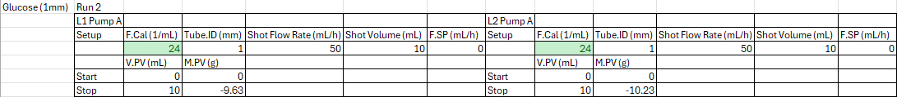
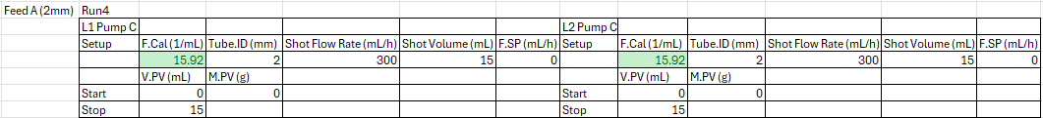

F.Cal Values
Pump A – glucose – (1 mm): F.Cal: 24
Shot Flow Rate: 50 mL/h
Shot Volume: 10 mL
Pump C – Feed A – (2 mm): F.Cal: 15.92
Shot Flow Rate: 300 mL/h
Shot Volume: 15 mL
Calibration Process:
Achieved within 10% accuracy using trial and error.
Notes:
Intro to F.Cal Values:
"This slide presents the calibration values used for Pumps A and C. These values are crucial for ensuring the accurate delivery of feed into the bioreactor."
Calibration Process:’
“We tested the new tube sets and got the following F.Cal values. Determine new F.Cal values which seemed consistent between different pumps and stations.”
"We achieved the calibration values through a trial and error approach, fine-tuning them to ensure they remain within a 10% accuracy threshold which can be reduced over time, after more runs. This precision is essential for the reliability and efficiency of our bioreactor operations."

